Slide 1
Financial Education Series Volume 1– Updated October 2015
presents
Know Your Credit Report

Slide 2
Purpose
Know Your Credit Report
Know Your Credit Report will teach you how to order, read and understand your credit report.
It will also provide tips in correcting simple errors you may find.

Slide 3
Handouts
Know Your Credit Report
Sample Credit Reports
Credit Release Authorization Forms
Kroll Factual Data
Dispute Letters
Debt Validation
Credit Report Review Form
Tips for Correcting Errors
Annual Credit Report Request Form

Slide 4
Ordering and Reading
Know Your Credit Report
Ordering/reading a credit report will help determine if all of the information is:
accurate
belongs to customer
Notes:
The first step in working on credit report is ordering and reading a credit report.

Slide 5
Ordering Process
Know Your Credit Report
Step One: visit www.annualcreditreport.com
Step Two: Click either of the following links.
or
Which will take you to…

Slide 6
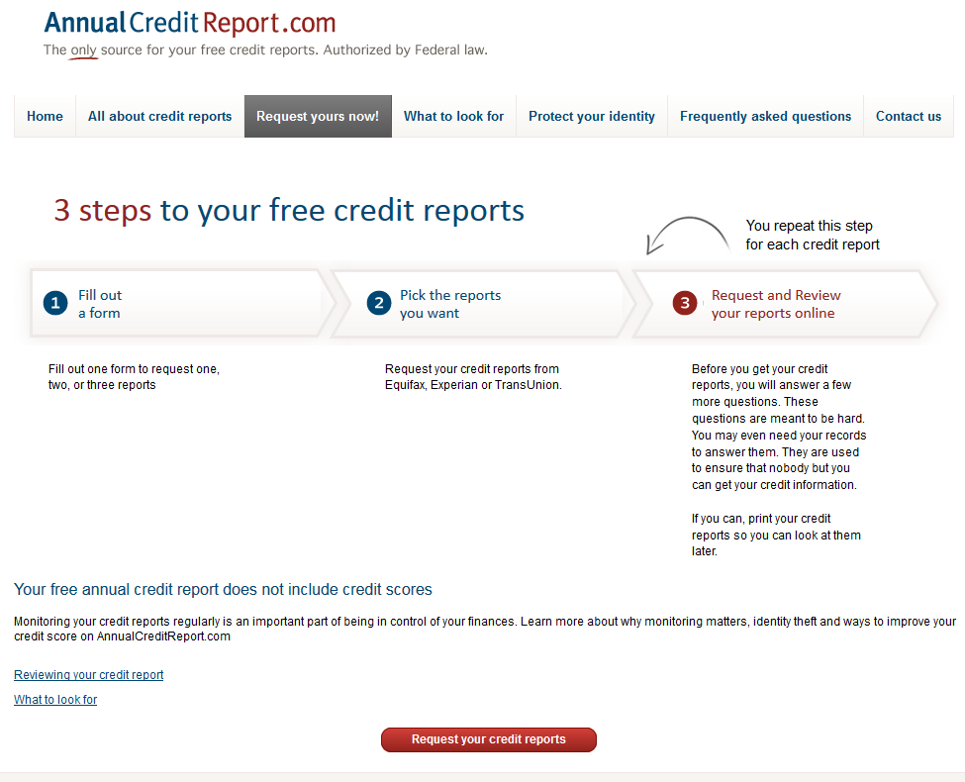
Ordering Process
Know Your Credit Report
Click the “Request your credit reports button.”

Slide 7
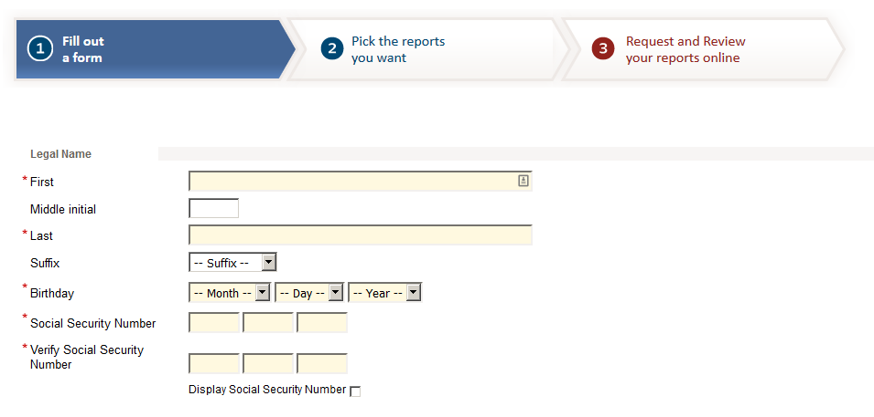
Ordering Process
Know Your Credit Report
Step Three: Complete the form.

Slide 8
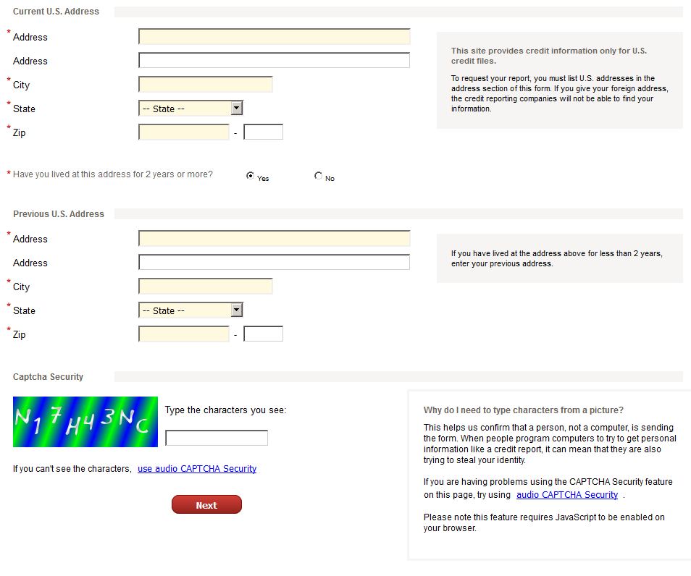
Ordering Process
Know Your Credit Report
Notes:
Completing this screen will take you to another screen that will verify your customer’s information. The system will ask some identifying questions. It is therefore important that the customer is available to answer those questions accurately. Questions answered incorrectly will result in the system denying access to the credit report.
If access is denied on the online option, you can provide customer with an option to mail a request in to order the credit, using the annual credit report request form. This option might take anywhere between 30-45 days before customer receives the credit report.

Slide 9
Ordering Process
Know Your Credit Report
Step Four: Select your report.
Notes:
Notes: customer are able to order their credit report (no score) once a year
Customer has the option of ordering all three credit report at the same time
in this case, customer will have to waiting a full 12 months before they can order again
Or customer can order one credit report per quarter.
These options will depend on what the customer is trying to do. For example, if a customer is trying to purchase a big ticket item, it might be prudent to have all three reports at the same.
Caution: Just because errors on one credit report is corrected, does not mean that error is corrected on the others.

Slide 10
Credit Report Information
Know Your Credit Report
1. Identifying information, including:
Name
Social Security Number (SSN)
Current and previous addresses
Telephone number
Birth date
Current and previous employers
Notes:
The reports from each of the credit agencies look different, but generally contain the same basic information.
Reading credit report entails looking over the report with the customer, and verifying contained in the report. We are doing this with the customer to ensure that information contained in this report is accurately, and it belongs to the customer. A credit report might contain accurately information but that information might not belong to the customer sitting with you.
Example.
Notes: With experian, the current and previous addresses, SS#, date of birth and employer information are located on the last page of the report.
The only time an employer appears on the credit report is, if that employer ordered the credit report during the hiring process.

Slide 11
Credit Report Information
Know Your Credit Report
2. A credit history
3. A list of inquiries
Those that do not affect a credit score. (soft pull)
Those that do affect a credit score. (hard pull)
Notes:
Credit history, refers to all tradelines, open, closed current and delinquent accounts on a credit report. The history is what makes the credit report
The inquiries section of the credit report contains a list of everyone who accessed the credit report within the last two years
including voluntary inquiries spurred by your own requests for credit and inquiries from lenders and other companies you authorized to order your credit report.
Inquiries as a result of a request made by the individual will not influence your credit score.
But, inquiries from lenders and potential creditors can be a factor in the credit score.

Slide 12
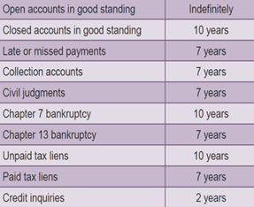
Credit Report Information
Know Your Credit Report
4. A public record, for example:
bankruptcies
foreclosures
tax liens
civil judgments
Notes:
These items can stay on ones credit report from 7-10 years
State Tax lien can include: income taxes, property taxes, and unemployment overpayment
7 years, starting from the last date of activity
Civil Judgment is when any of your creditors (medical, phone, utilities, credit card, landlords, apartment complexes etc. companies) files lawsuit against the customer due to non payment.

Slide 13
Credit Report Information
Know Your Credit Report
5. Negative information
Collection accounts
Including: medical, utilities etc.
Delinquent student loan payments
Late child support payments
Repossession

Slide 14
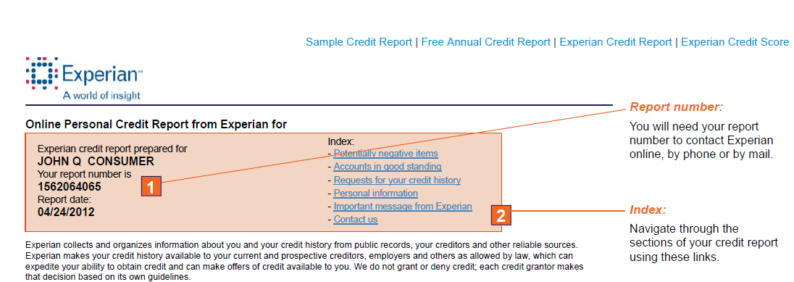
Sample Experian Report
Know Your Credit Report
Notes:
Report Number:
This is unique # for each report pulled
Indexes: one can click on any of the indexes, and it will take you directly to what you want to see instead of the scrolling up and down the entire report

Slide 15
Trade Lines
Know Your Credit Report
Notes:
Potentially negative items, are those are late payments and past dues, collections etc.

Slide 16
Trade Lines
Know Your Credit Report
Notes:
Potentially negative items, are those are late payments and past dues, collections etc.

Slide 17
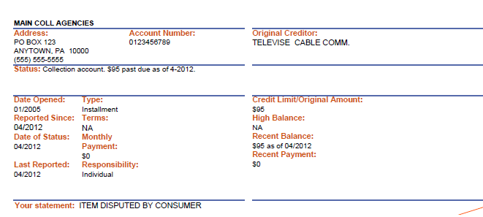
Negative Accounts
Know Your Credit Report
Notes:
Potentially negative items, are those are late payments and past dues, collections etc.

Slide 18
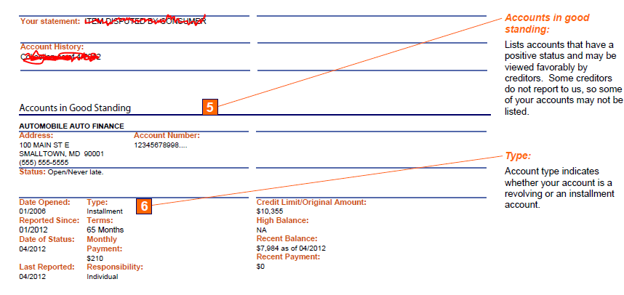
Good Standing Accounts
Know Your Credit Report

Slide 19
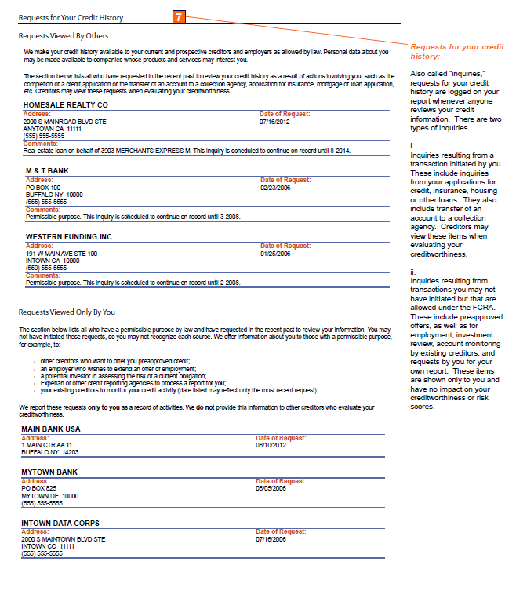
Inquiries
Know Your Credit Report
Notes:
A list of everyone who has requested the credit report.
“Hard inquiries” are the result of your application for credit and are shared with your lenders when you apply for new services.

Slide 20
Inquiries
Know Your Credit Report
Notes:
“Soft inquiries” show only in the personal credit report and include requests for preapproved credit offers, insurance, employment, account review by current lenders and the individual’s requests to order your own report.

Slide 21
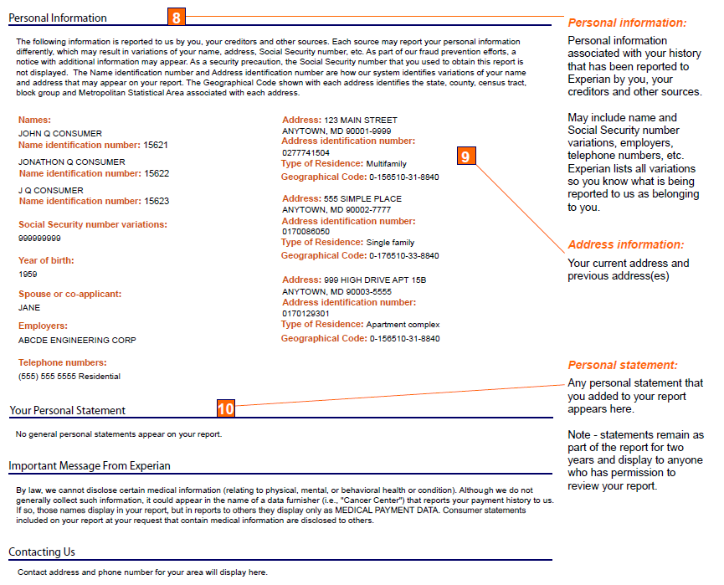
Personal Information
Know Your Credit Report

Slide 22
Personal Information
Know Your Credit Report

Slide 23
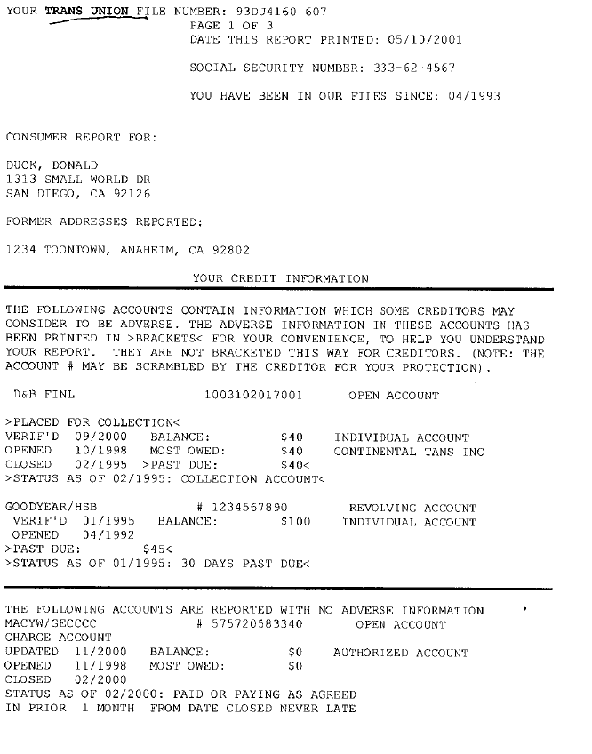
Sample Transunion Report
Know Your Credit Report

Slide 24
Sample Transunion Report
Know Your Credit Report

Slide 25
Sample Transunion Report
Know Your Credit Report

Slide 26
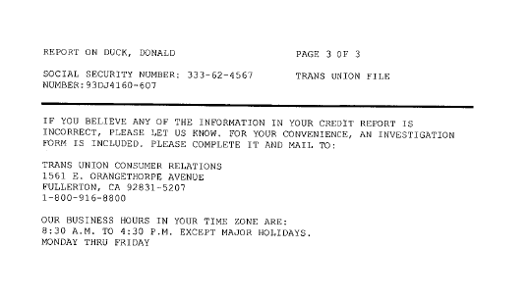
Sample Transunion Report
Know Your Credit Report

Slide 27
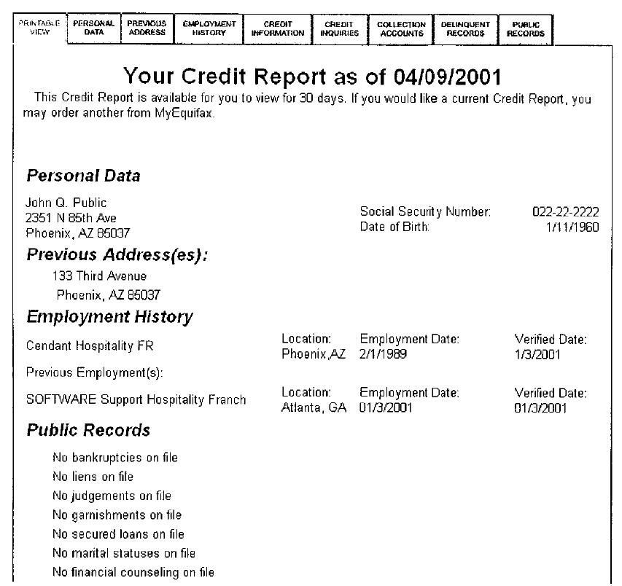
Sample Equifax Report
Know Your Credit Report

Slide 28
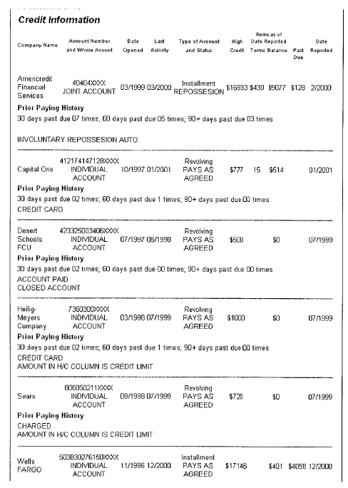
Sample Equifax Report
Know Your Credit Report

Slide 29
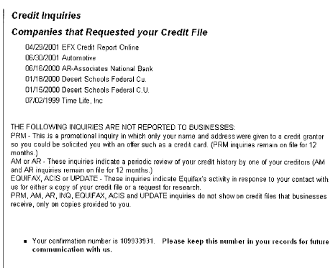
Sample Equifax Report
Know Your Credit Report

Slide 30
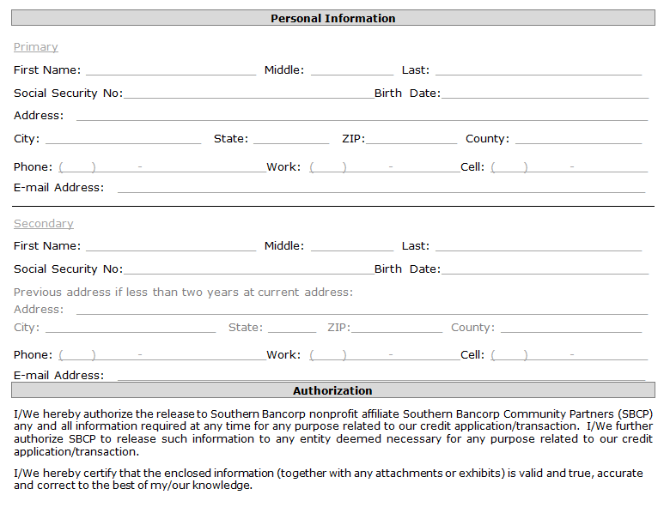
Credit Information Release
Know Your Credit Report
Notes:
If using annualcreditreport.com customer has to be present because they will have to answer questions on certain personal information.

Slide 31
Sample Kroll Factual Data
Know Your Credit Report
PERSONAL IDENTIFICATION:
Last Name: Consumer First Name: John Middle: P. Suffix Age: 33 Social Security : 022-22-2222
RESIDENCE INFORMATION
Present
3505 Lone Pine Starkville MS 39759 Telephone: 662-444-4444
PUBLIC RECORDS
Tax Lien BU/BX/BQ State Tax Lien Docket # 880H62 1,876 Status: Filed
Court Type: Jasper County Filed: 10/13/2014 Status Date: 10/14
INQUIRY INFORMATION
08/14/2015 Good Faith Fund (BU1)(BQ1)(BX1)
Database Residence Information
875 South State Street Clarksdale MS 388614 04/11 08/15
610 Main Street Arkadelphia AR 71923 12/01 03/11
Employer/Position/Dates of employment
Southern Bancorp Bank Teller 10/11 to 08/15
OFAC Compliance
AKA- John P. Consumer, John Percy Consumer, J. Percy Consumer
Credit Score Information
489 Experian FICO 444-44-444 John P. Consumer
38- Serious delinquency and public record or collection
13- Time since delinquency is too recent or unknown
18- Number of accounts with delinquency
10- Ratio of balance to limit on bank revolving or other revolving accounts is too high
Notes:
The credit score is the numerical value in the left hand corner along with the bureau that score was taken from.
The type of score obtained. (If paying for a score the FICO is the most commonly used score in loan making decisions)
Client social security number and the client’s name identifying the consumer the report belongs to.
Next, the numerical reason codes with an explanation of why their score is where it is and how it is scored based on numerical values assigned to financial transactions as they occur when added to the formula used to compute the score.
Most are self explanatory but if you are not sure call Vida or myself for clarity.
The credit history will contain the account holder’s name and account number, date the account was opened, date the account was last reported to the bureau, the highest account balance reported, length of review(how far back did they review account for reporting), number of late payments and dates, account amount past due, payment of account, and balance if any.
Last active- any payments made etc, high limit of credit extended, type of account (auto, installment, student loan etc.)
Total amount of credit available, total high balance, total amount pastdue, total payments, and total balance owed.
Creditor Contact Information
Name and address of each bureau’s Consumer Relations Department
How many of you have spotted an error on this report?
The credit score is the numerical value in the left hand corner along with the bureau that score was taken from.
The type of score obtained. (If paying for a score the FICO is the most commonly used score in loan making decisions)
Client social security number and the client’s name identifying the consumer the report belongs to.
Next, the numerical reason codes with an explanation of why their score is where it is and how it is scored based on numerical values assigned to financial transactions as they occur when added to the formula used to compute the score.
Most are self explanatory but if you are not sure call Vida or myself for clarity.
The credit history will contain the account holder’s name and account number, date the account was opened, date the account was last reported to the bureau, the highest account balance reported, length of review(how far back did they review account for reporting), number of late payments and dates, account amount past due, payment of account, and balance if any.
Last active- any payments made etc, high limit of credit extended, type of account (auto, installment, student loan etc.)
Total amount of credit available, total high balance, total amount pastdue, total payments, and total balance owed.
Creditor Contact Information
Name and address of each bureau’s Consumer Relations Department
How many of you have spotted an error on this report?

Slide 32
Sample Kroll Factual Data
Know Your Credit Report
Equifax FICO 444-44-4444 John P. Consumer 38- Serious Delinquency, and derogatory public record or collection filed 18- Number of accounts with delinquency 13- Time since is too recent or unknown 10- Proportion of balances to credit limits is too high
Transunion FICO 444-44-4444 John P. Consumer 038- Serious delinquency and public record or collection filed 013- Time since delinquency is too recent or unknown 018- Number of accounts with delinquency 010- Proportion of balances to credit limits is too high on bank revolving or other revolving accounts
CREDIT HISTORY
Account Name Opened Reported High Balance Reviewed 30 60 90 Past due Payment Balance Sears 09/07 07/15 8,347 18 months 1 1 1 12,126 Profit/Loss 5,202 90857643 Last Active Bureau High Limit Type of Account 03/10 BU/BQ/BX ------ Auto
Totals High Credit High Balance Past due Payment Balance
8,347 5,202 Creditor Information
Capitol One Bank USA N (800)955-7070 15000 Capital One Drive, Richmond, VA 23238
Name, Address and Telephone number of each bureau’s Consumer Relations Department for disputes

Slide 33
Determining Credit Scores
Know Your Credit Report

Slide 34
Getting Good Credit
Know Your Credit Report
Only apply for credit if it is really needed
Get the right kind of credit
Watch the spending and debt ratio
Do not spend more than 30% of available credit
Notes:
installment credit. Any loan, including mortgages and car loans, in which the total debt is divided into amounts that must be repaid regularly with interest over a specific length of time is
open-ended credit (also called revolving credit) a kind of loan which includes credit cards and some home equity loans. Open-ended credit allows borrowers to draw on a certain line of credit when needed as long as they make regular payments on the outstanding balance.
Non-installment credit includes monthly charge cards like American Express.
The more debt one has in relation to income or available credit lines, the more the person will be viewed by lenders as a higher risk borrower.
For example, all of your monthly obligations (rent/mortgage, car payments, school loans, credit card payments, etc.) should be less than or equal to 33 to 36 percent of your monthly gross income.

Slide 35
Getting Good Credit
Know Your Credit Report
Pay all bills on time
Enroll in a credit builder product
Look for ways to cut expenses
Dispute/correct errors on your report

Slide 36
Disputes
Know Your Credit Report
Disputes can be handled in different ways:
Calling the creditor identified in the credit report.
Calling the credit bureau that is reporting the information.
Sending a letter to the credit bureau, clearly stating the reason for the dispute.
Notes:
The next step after reviewing a credit report is to determine (with the customer) what to do about information in the credit report. If there are errors in the credit report, staff can assist customer in correcting those errors by disputing those errors. Disputes, can be handle in different ways
Calling the creditor identified in the credit report
Calling the credit bureau reporting the information – customer can call credit bureau if phone # is not available on the creditor. Credit Bureau, in most cases, will be able to provide creditor information.
Sending a letter to the credit bureau, clearly stating the reason for the dispute
Provide customers with:
Dispute letters (whichever is applicable)
Deletions
proposal to settle
corrections to credit report
consumer statement
debt validation
Credit report review form
Notes: Some information might be negative but not inaccurate. Make sure the customer understands that just because the information is negative, does not mean it is inaccurate.

Slide 37
Frequently Asked Questions
Know Your Credit Report
Will pulling my credit affect my score?
How will paying on time help me build good credit history?
I have no credit, what information can be used to establish a credit?
Will paying a collection account immediately improve my credit score?
Notes:
The next step after reviewing a credit report is to determine (with the customer) what to do about information in the credit report. If there are errors in the credit report, staff can assist customer in correcting those errors by disputing those errors. Disputes, can be handle in different ways
Calling the creditor identified in the credit report
Calling the credit bureau reporting the information – customer can call credit bureau if phone # is not available on the creditor. Credit Bureau, in most cases, will be able to provide creditor information.
Sending a letter to the credit bureau, clearly stating the reason for the dispute
Provide customers with:
Dispute letters (whichever is applicable)
Deletions
proposal to settle
corrections to credit report
consumer statement
debt validation
Credit report review form
Notes: Some information might be negative but not inaccurate. Make sure the customer understands that just because the information is negative, does not mean it is inaccurate.

Slide 38
Frequently Asked Questions
Know Your Credit Report
What is the ideal number of credit cards to carry?
When debt collectors contact individuals about an old debt, does it have to be paid?
How many points does an inquiry take off an individual’s credit score?
Can collection agencies call the neighbors?
Notes:
Shopping for a mortgage or an auto loan may cause multiple lenders to request an individual’s credit report. To compensate for this, the score ignores all mortgage and auto inquiries made in the 30 days prior to scoring. After 30 days, multiple inquiries relating to a mortgage or auto loan application in a typical shopping period are treated as one inquiry. That means that the credit score is not harmed by shopping around for the best car or home loan.

Slide 39
Credit Myths
Know Your Credit Report
Credit reporting companies decide whether an application should be approved or declined.
Paying a collection account will reset the 7 year deletion period.
Negative accurate items can and should be disputed.
Credit cards are bad for you.
Credit bureaus are responsible for bad credit.
Notes:
Shopping for a mortgage or an auto loan may cause multiple lenders to request an individual’s credit report. To compensate for this, the score ignores all mortgage and auto inquiries made in the 30 days prior to scoring. After 30 days, multiple inquiries relating to a mortgage or auto loan application in a typical shopping period are treated as one inquiry. That means that the credit score is not harmed by shopping around for the best car or home loan.

Slide 40
Questions?
Know Your Credit Report
Notes:
Shopping for a mortgage or an auto loan may cause multiple lenders to request an individual’s credit report. To compensate for this, the score ignores all mortgage and auto inquiries made in the 30 days prior to scoring. After 30 days, multiple inquiries relating to a mortgage or auto loan application in a typical shopping period are treated as one inquiry. That means that the credit score is not harmed by shopping around for the best car or home loan.

Slide 41
Additional Resources
Know Your Credit Report
www.annualcreditreport.com
www.experian.com/credit_report_basics/pdf/samplecreditreport.pdf
Equifax: 1-800-685-1111 or www.equifax.com
Experian: 1-888-EXPERIAN (397-3742) or www.experian.com
TransUnion: 1-800-916-8800 or www.transunion.com
You can print a copy of the Annual Credit Report Request Form from www.annualcreditreport.com or www.ftc.gov/credit
Call toll-free: 1-877-322-8228
Complete the Annual Credit Report Request Form and mail it to:
Annual Credit Report Request Service P. O. Box 105281 Atlanta, GA 30348-5281
Notes:
Shopping for a mortgage or an auto loan may cause multiple lenders to request an individual’s credit report. To compensate for this, the score ignores all mortgage and auto inquiries made in the 30 days prior to scoring. After 30 days, multiple inquiries relating to a mortgage or auto loan application in a typical shopping period are treated as one inquiry. That means that the credit score is not harmed by shopping around for the best car or home loan.

