Slide 1

Banking
Services
AVAILABLE FOR A
SMALL BUSINESS

Slide 2
Agenda
Welcome, Pre-Test, Agenda, and Learning Objectives
Business Banking Fundamentals
Choosing the Right Bank
Additional Banking Services
Improve Your Chances of Getting a Loan
Summary, Post-Test, Evaluation

Slide 3
Learning Objectives
Identify the banking services commonly available to a small business and explain how these services work.
Identify the advantages and disadvantages of each of the banking services.
Explain how small business owners decide which banking services are best for their business.
Define several forms of deposit insurance.

Slide 4
Learning Objectives, cont.
Describe some benefits of building effective long-term relationships with a banker or lender.
Describe the role of a personal credit score in the lending process.
Explain the benefits of separating business and personal bank transactions.

Slide 5

Introductions: What Do You Want to Know?
What do you know or want to learn about banking servcies?
Notes:
Before we begin, we want to see what you know about financial management for a small business.

Slide 6

Business Banking Fundamentals
Factors to consider when deciding what banking services you need
Checking accounts
Savings accounts and certificates
of deposit
Account access

Slide 7

Discussion Point #1: Banking Services
Discuss the banking services you need.
What are some of the services you try to find in a bank?

Slide 8

Business Banking Fundamentals
Choosing the right bank
  ATM usage and availability
  Customer service and relationship
  Accessibility: drive or walk, parking,
  drive-through
  Products and services
  Fees
  Deposited funds availability

Slide 9

Business Banking Fundamentals
Checking accounts
  Small business or commercial checking
  Payroll and operating accounts – “Zero balance” feature (sweeps) and fees
  Do not mix business and personal transactions (no “co-mingling”)

Slide 10
Do Not Mix Business and Personal Transactions
  Avoid “co-mingling”
  Ensure accurate bookkeeping
  Avoid tax consequences
  Follow a proper protocol to transfer funds (ask your bank for how to generate a record of activity)

Slide 11
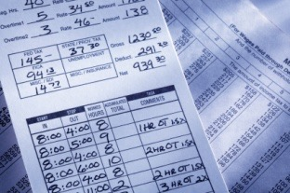
Additional Banking Services
Payroll services
  Prevent potential fraud or forgeries
  Record keeping
  Direct deposit

Slide 12
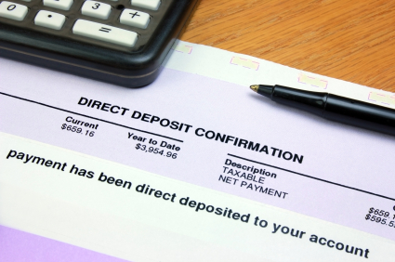
Additional Banking Services
Cash management services
  Sweep investment account
  Other sweep accounts
  Online funds transfer
  Lockbox service
  Positive pay
  Ask your Bank

Slide 13

Business Banking Fundamentals
Savings accounts and certificates of deposit
  Savings accounts – limitations on withdrawals and types of accounts
  Certificates of deposit

Slide 14

Business Banking Fundamentals
Business account access
  Depositing sales with
  remote deposit scanner
  Online access
Beware online theft!

Slide 15

Deposit Insurance In-Depth
Deposit insurance covers businesses that have:
  Sole proprietorships
  Corporations, partnerships and unincorporated associations such as not-for-profits and for-profits
  Fiduciary Accounts

Slide 16
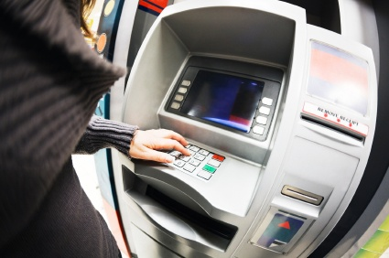
Additional Banking Services
Business debit card
  Owner or others
  Convenience and risk

Slide 17

Additional Banking Services
Merchant processing services - expand capabilities and sales
  Credit cards
  Debit cards
  Gift cards
  Online payments
  and sales

Slide 18
Discussion Point # 2: Banking Service Needs
See page 16 in your Participant Guide.
Use three columns
Column 1: List services you need now
Column 2: List anticipated services for the next six months to a year
Column 3: List services you plan to get in the next two years, or see as future needs of the business
Assign a date to have each service in place or re-evaluated. How will your banking services needs change over the next two years?

Slide 19

Business Banking Fundamentals
Reconciling accounts
  Deposit accounts
  Remote deposit scanner
  Interest
  Loans

Slide 20
Business Banking Fundamentals
Protecting your business from online theft
  Use strong passwords and change frequently
  Ensure computers have latest operating system and anti-virus security updates
  Avoid using public wireless hot spots in areas like airports or cafes for online banking activity
  Ensure your staff thinks critically about emails and phone calls to identify suspicious behavior
  Consider establishing a dedicated computer for online banking and cash management

Slide 21

Additional Banking Services
Commercial lending
  Financing receivables and purchased inventory
  Lines of credit
  Term loans for fixed assets

Slide 22
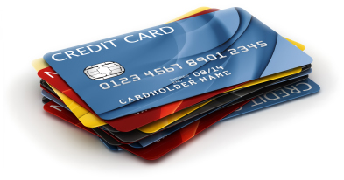
Additional Banking Services
Business credit card
  Owner or others
  Convenience and risk

Slide 23

Additional Banking Services
Commercial lending
Small Business Administration
Loan Guarantees

Slide 24
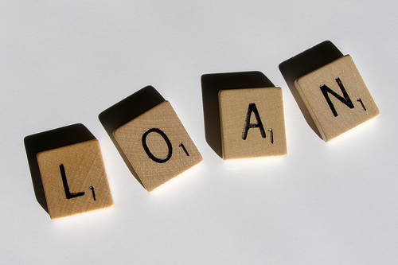
Improve Chances Getting a Business Loan
  Develop the five C’s of credit
  Do your homework, ask questions
  Build long-term relationships with your banker
  Improve your personal credit score

Slide 25

Additional Banking Services
Financing
  Comparison shop
  Understand types of financing

Slide 26

Additional Banking Services
Commercial lending
Ask about:
  Loan details, features, terms, etc.
  Loan types
Find out what you will need
to provide

Slide 27

Additional Banking Services
Wealth management and retirement planning
  SIMPLE IRA
  401(k) retirement savings plan
  Simplified Employee
  Pension (SEP) plan
  ROTH IRA
  Health savings plan

Slide 28
Key Points to Remember
Choose the right bank for your financial needs.
Banks offer a wide range of loan and deposit products and services to meet your needs. Shop around.
Keep your business and personal accounts separate.
Take precautions to avoid fraud or other preventable losses.

Slide 29
Key Points to Remember, cont.
Establish a cushion for unexpected expenses, perhaps in a savings account.
Know your personal credit score. If it is low, take steps to increase it .
To improve your chances of getting a loan, develop the five C’s of credit.
Build a strong relationship with a lender before, during, and after the loan process.

Slide 30

Summary
  What final questions do you have?
  What have you learned?
  How would you evaluate the training?

Slide 31
Conclusion
You learned about:
  Evaluating your business and what banks have to offer
  Different bank accounts and services
  Questions to ask
  Building a bank relationship over time, based on your needs

Slide 32

Pre-Post Test and Evaluation
If you have not already done so, assess what your knowledge on this topic was before you participated in this class.
Assess your knowledge on this topic after taking this class.
Complete the Evaluation Form. Your feedback is helpful!
Return both forms to the instructor before you leave. Thank you!
In your workbook

